Slide 1
CSC 462: Machine Learning
5.4 Underfitting and Overfitting
5.5 Regularization
Dr. Sultan Alfarhood

Slide 2
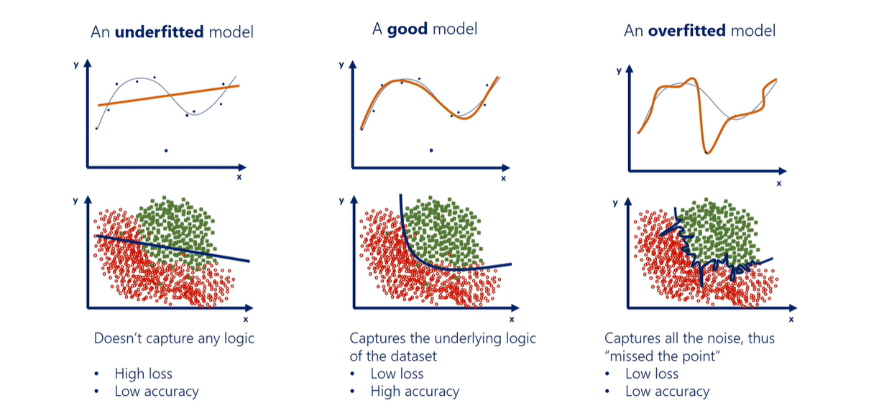
Underfitting and Overfitting

Slide 3

Underfitting
Underfitting is the inability of the model to predict well the labels of the data it was trained on.

Slide 4
Underfitting
There could be several reasons for underfitting, the most important of which are:
The model is too simple for the data
For example, a linear model can often underfit
The features you engineered are not informative enough
The solution of underfitting is to try a more complex model or to engineer features with higher predictive power.

Slide 5
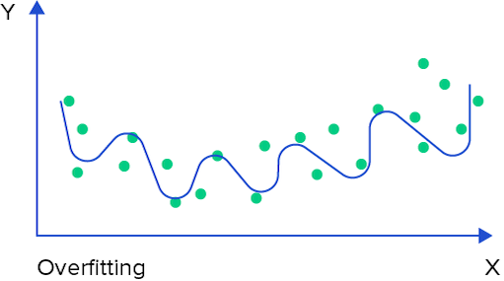
Overfitting
The model that overfits predicts very well the training data but poorly the data from at least one of the two hold-out sets.
Also referred to as the problem of high variance.

Slide 6
Overfitting
Several reasons can lead to overfitting, the most important of which are:
The model is too complex for the data
For example, a very tall decision tree or a very deep or wide neural network often overfit
Too many features but with a small number of training examples

Slide 7
Overfitting
Several solutions to the problem of overfitting are possible:
Try a simpler model
Linear instead of polynomial regression
SVM with a linear kernel instead of RBF
A neural network with fewer layers/units
Reduce the dimensionality of examples in the dataset
For example, by using one of the dimensionality reduction techniques discussed in Chapter 9
Add more training data, if possible
Regularize the model

Slide 8
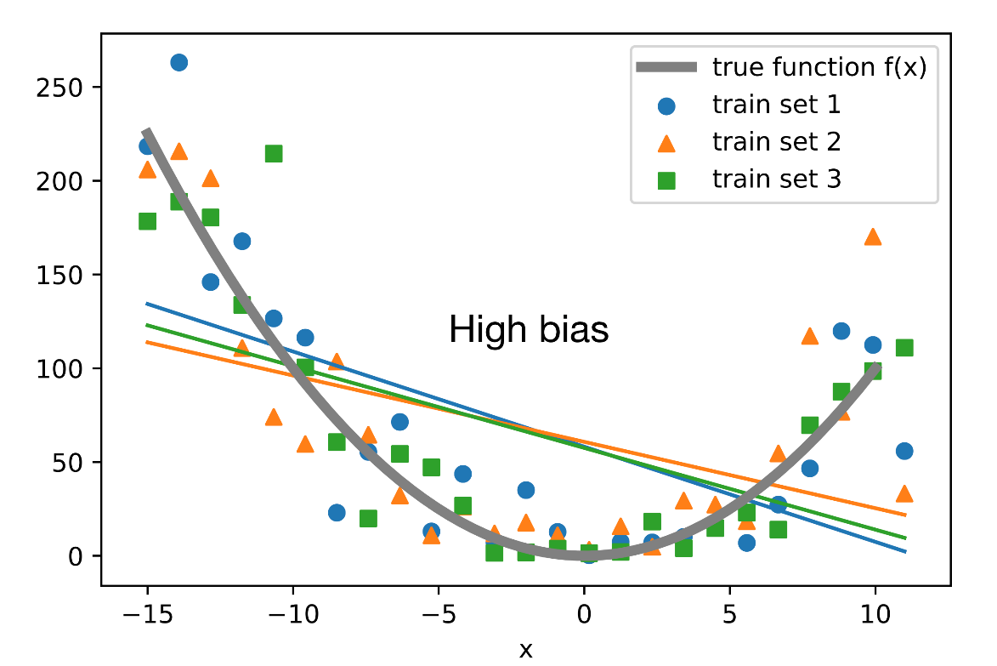
Bias
Bias is the difference between the average prediction of our model and the correct value which we are trying to predict
If the model makes many mistakes on the training data, we say that the model has a high bias or that the model underfits
A model has a low bias if it predicts well the labels of the training data.

Slide 9
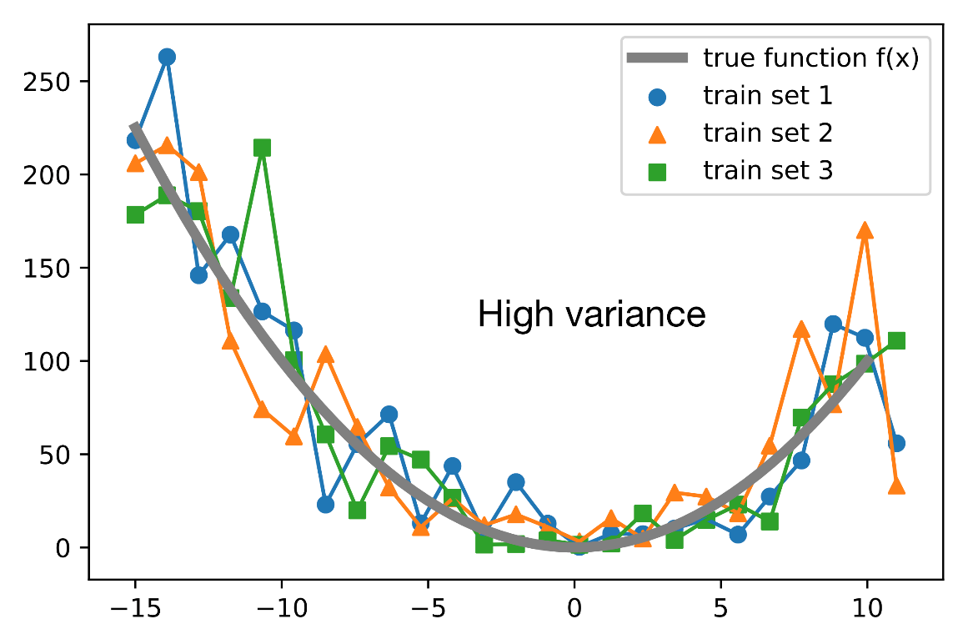
Variance
The variance is an error of the model due to its sensitivity to small fluctuations in the training set
Variance describes how much a model changes when trained using different portions of a data set.

Slide 10
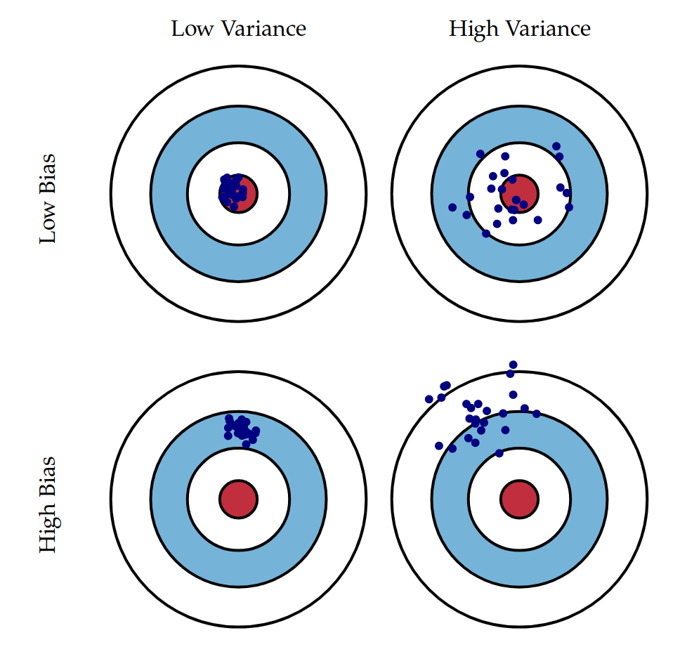
Bias & Variance

Slide 11
Regularization
Regularization is a general term that includes methods that force the learning algorithm to build a less complex model
A penalty is imposed on models, which are very complex
In practice, that often leads to slightly higher bias but significantly reduces the variance.
This problem is known in the literature as the bias-variance tradeoff

Slide 12
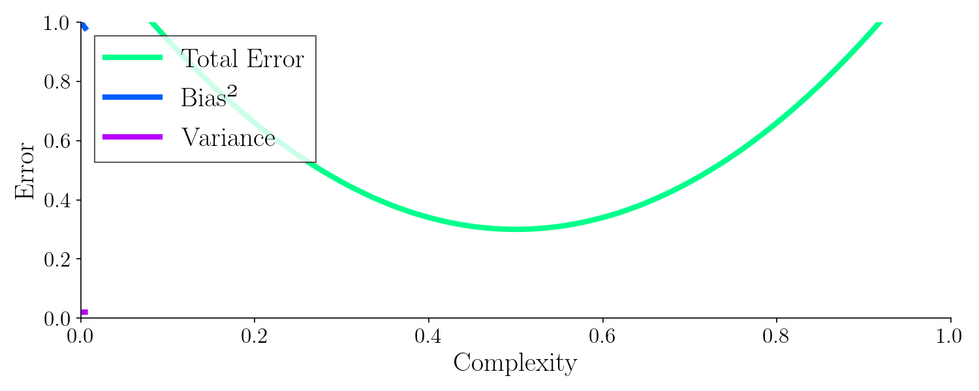
Bias-variance Tradeoff (Animated)
Bias is the difference between the average prediction of our model and the correct value which we are trying to predict
Variance is an error of the model due to its sensitivity to small fluctuations in the training set

Slide 13
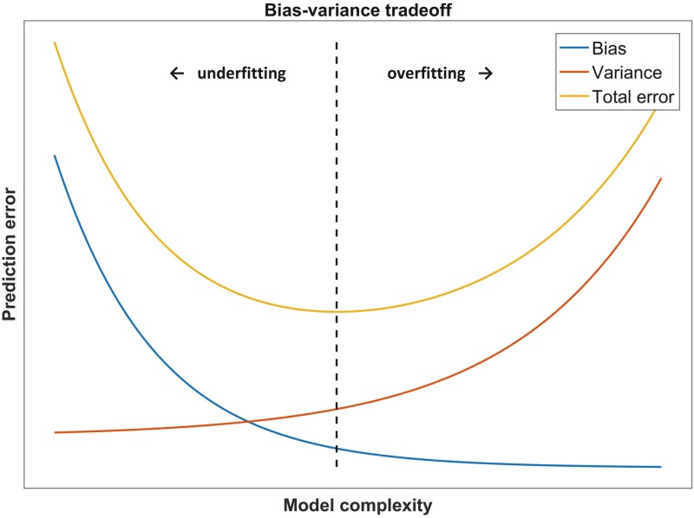
Bias-variance Tradeoff
Bias is the difference between the average prediction of our model and the correct value which we are trying to predict
Variance is an error of the model due to its sensitivity to small fluctuations in the training set

Slide 14
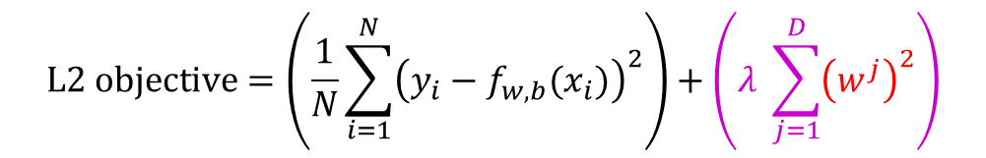
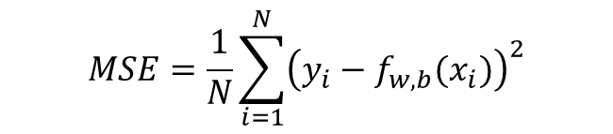
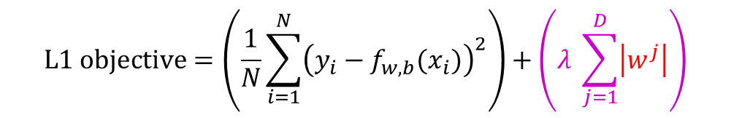
Regularization
$$MSE=\frac{1}{N}\sum_{i=1}^{N}{{\left(y_{i}−f_{w,b}(x_{i})\right)}^{2}}$$
Regularization is the most widely used approach to prevent overfitting
The two most widely used types of regularization are
L1 regularization (Lasso Regression)
L2 regularization (Ridge Regression)
$$L1 objective=\left(\frac{1}{N}\sum_{i=1}^{N}{{\left(y_{i}−f_{w,b}(x_{i})\right)}^{2}}\right)+\left(λ \sum_{j=1}^{D}{\left|w^{j}\right|}\right)$$
$$L2 objective=\left(\frac{1}{N}\sum_{i=1}^{N}{{\left(y_{i}−f_{w,b}(x_{i})\right)}^{2}}\right)+\left(λ \sum_{j=1}^{D}{{\left(w^{j}\right)}^{2}}\right)$$
λ is the regularization coefficient which determines how much regularization we want.

Slide 15
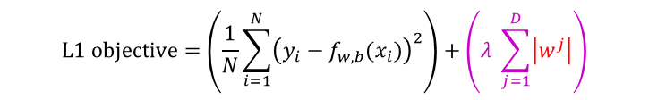
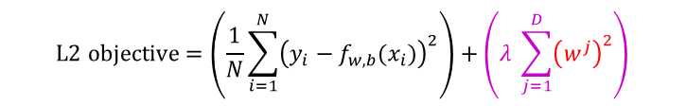
L1 & L2 Regularization
To create a regularized model, we modify the objective function by adding a penalizing term whose value is higher when the model is more complex.
The key difference between these techniques is that L1 shrinks the less important feature’s coefficient to zero thus, removing some feature altogether
So, this works well for feature selection in case we have a huge number of features
L1 regularization (Lasso Regression):
L2 regularization (Ridge Regression):
$$L1 objective=\left(\frac{1}{N}\sum_{i=1}^{N}{{\left(y_{i}−f_{w,b}(x_{i})\right)}^{2}}\right)+\left(λ \sum_{j=1}^{D}{\left|w^{j}\right|}\right)$$
$$L2 objective=\left(\frac{1}{N}\sum_{i=1}^{N}{{\left(y_{i}−f_{w,b}(x_{i})\right)}^{2}}\right)+\left(λ \sum_{j=1}^{D}{{\left(w^{j}\right)}^{2}}\right)$$
λ is the regularization coefficient which determines how much regularization we want.

Slide 16
L1 & L2 Regularization
In practice, L1 regularization produces a sparse model
A model that has most of its parameters equal to zero (provided the hyperparameter λ is large enough).
L1 makes feature selection by deciding which features are essential for prediction and which are not.
That can be useful in case you want to increase model explainability
However, if your only goal is to maximize the performance of the model on the hold-out data, then L2 usually gives better results.

Slide 17
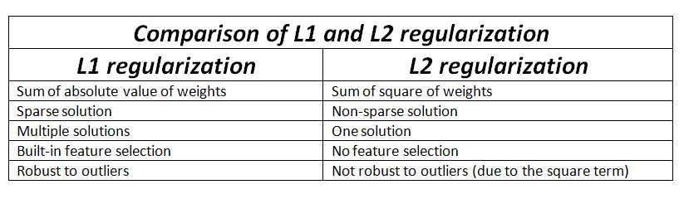
L1 & L2 Regularization

